Slide 1
🧙‍♀️ Mage &
🏎️ DTC Zoomcamp
💫 Making Orchestration Magical with Mage

Slide 2
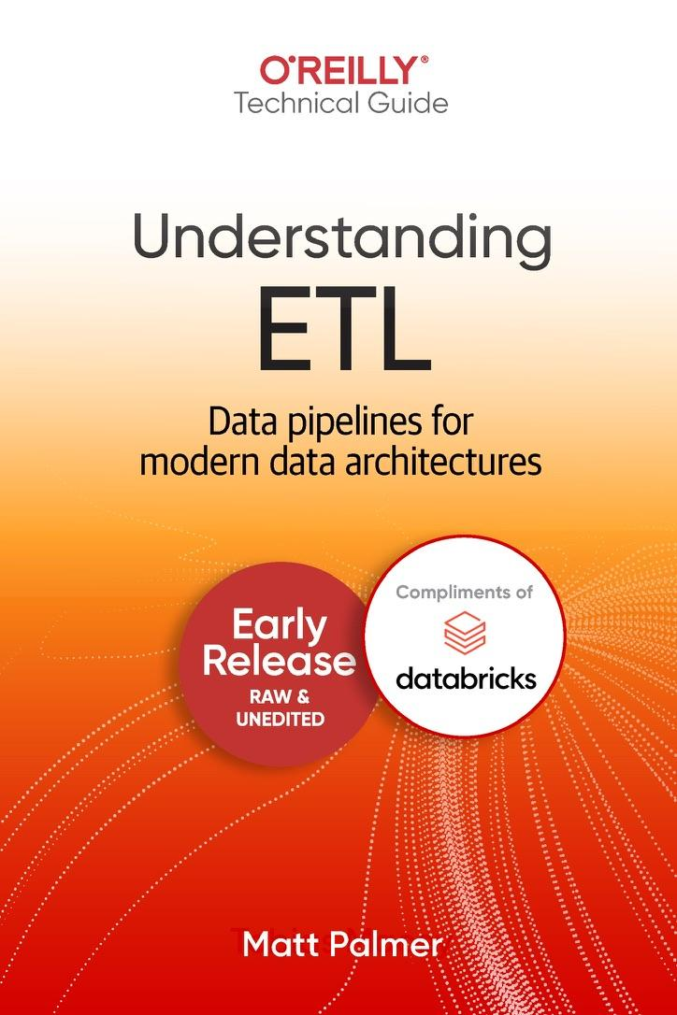


🙋‍♂️ A bit about me…
↩️ Previously
Analytics engineering
Product analytics
Data engineering
🔄 Now
DevRel (& other stuff)
Storyblocks 📹
AllTrails 🥾
Underline 💻
Mage 🧙🏻‍♂️

Slide 3


🤝 Connect on LinkedIn
🗞️ Check out my Newsletter

Slide 4
What will we build?

Slide 5
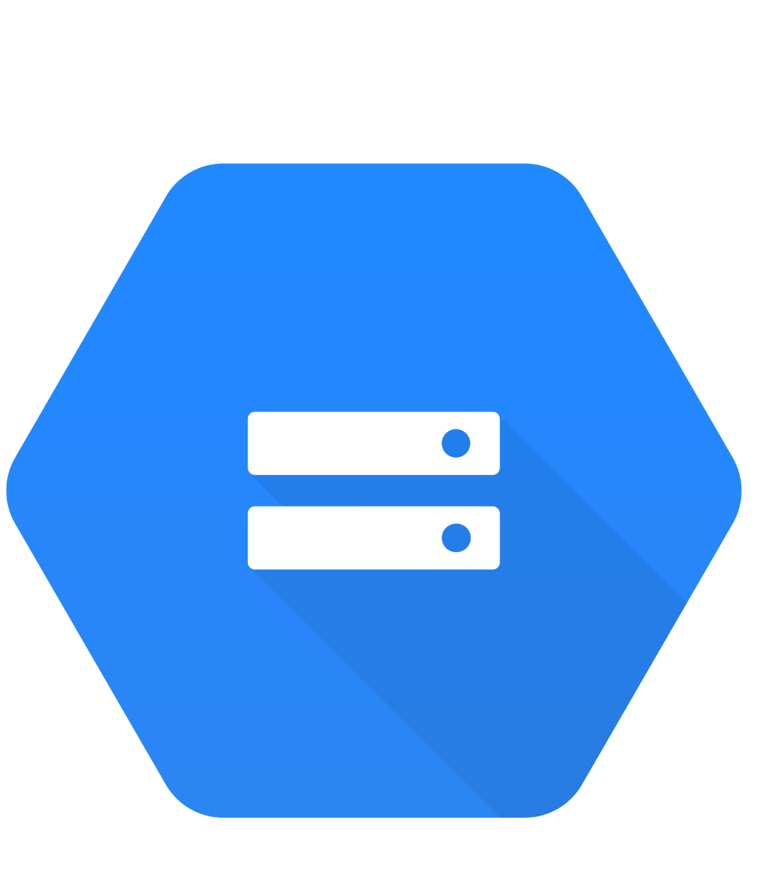









Load
🚕
Transform
Extract
Transform
Load
Load

Slide 6
Architecture
Extract
Pull data from a source (API— NYC taxi dataset)
Transform
Data cleaning, transformation, and partitioning.
Load
API to Mage, Mage to Postgres, GCS, BigQuery.

Slide 7
What is orchestration?

Slide 8
What is Orchestration?
A large part of data engineering is extracting, transforming, and loading data between sources.
Orchestration is a process of dependency management, facilitated through automation.
The data orchestrator manages scheduling, triggering, monitoring, and even resource allocation.

Slide 9
What is Orchestration?
☝️ Every workflow requires sequential steps.
☕️ A French press with cold water will only brew disappointment
☔️ Poorly sequenced transformations brew a storm far more bitter.
📕 Steps 🟰 tasks
🔄 Workflows 🟰 DAGs (directed acyclic graphs)

Slide 10
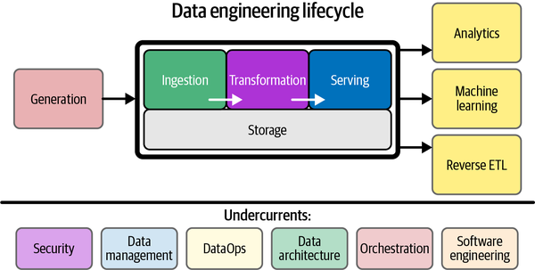
What is Orchestration?
Source

Slide 11
What does a good solution look like?

Slide 12




A good orchestrator handles…
Workflow management
Automation
Error handling
Recovery
Monitoring, alerting
Resource optimization
Observability
Debugging
Compliance/Auditing
Notes:
Workflow Management
Orchestrators assist in defining, scheduling, and managing workflows efficiently, ensuring tasks are executed in the right order by managing dependencies.
Automation
As engineers, we should be automating as much as possible (or feasible). Orchestrators can be used to automate routine, repetitive, and even complex tasks, saving time and ensuring tasks run as scheduled without manual intervention.
Error Handling and Recovery
Orchestrators often come with built-in error handling and recovery mechanisms. They can retry a failed task, notify the team, or trigger other tasks to fix the issue.
Monitoring and Alerting
Monitoring workflows and receiving alerts for failures or delays is crucial for maintaining reliable data pipelines. Orchestrators provide these capabilities.
Resource Optimization
By managing when and where tasks run, orchestrators help optimize resource use, which is crucial in environments with limited or costly resources.
Observability & Debugging
Orchestrators provide a visual representation of workflows, log management, and other debugging tools which are invaluable for troubleshooting and optimizing workflows.
Compliance & Auditing
Orchestrators maintain an audit trail of all tasks, which is crucial for compliance with data governance and other regulatory requirements.

Slide 13
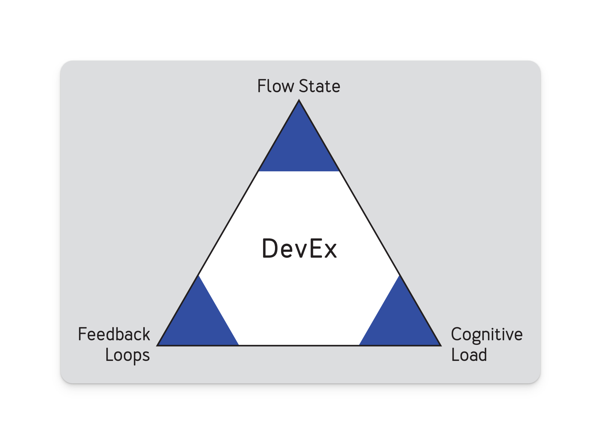

A good orchestrator prioritizes….
The developer experience
Flow state 🌊
“I need to switch between 7 tools/services.”
Feedback Loops 🔁
“I spent 5 hours locally testing this DAG.”
Cognitive Load 🧱
How much do you need to know to do your job?

Slide 14

An analogy
An orchestrator is like…

Slide 15
Up next: What is Mage?

